Slide 1
14. RELATIONAL DATABASE SERVICE (RDS)

Slide 2
RELATIONAL DATABASE SERVICE (RDS)
Amazon Relational Database Service (Amazon RDS) is a web service that makes it easier to set up, operate, and scale a relational database in the cloud. It provides cost-efficient, resizable capacity for an industry-standard relational database and manages common database administration tasks.
DB Instances: The basic building block of Amazon RDS is the DB instance. A DB instance is an isolated database environment in the cloud. A DB instance can contain multiple user-created databases, and you can access it by using the same tools and applications that you use with a stand-alone database instance.
Each DB instance runs a DB engine. Amazon RDS currently supports the MySQL, Maria DB, PostgreSQL, Oracle, and Microsoft SQL Server DB engines.
For each DB instance, you can select from 20 GB to 16 TB of associated storage capacity. Each DB instance class has minimum and maximum storage requirements for the DB instances that are created from it. It’s important to have enough storage so that your databases have room to grow and that features for the DB engine have room to write content or log entries.
DB instance storage comes in three types: Magnetic, General Purpose (SSD), and Provisioned IOPS (SSD). They differ in performance characteristics and price, allowing you to tailor your storage performance and cost to the needs of your database.
Considerations for running on EC2:
Have to build and design for high availability.
Must implement own backup solutions.
Must manage replication manually between master and slave databases.
Must manage tighter security controls.
Upgrading resources or any type of failover requires manual interaction or custom scripting.
Java App → EC2, ALB, AS and Oracle database --> RDS save cost, Automate, DR()Disaster Recovery -->

Slide 3
IAM (Identity Access Management)
Main features
Users
User groups
Policies
Roles
AWS End Point: Access point/link through which an aws service can be reached
RDS (Relational Database Service)- data is stored in the form of tables and columns
RDMS (Relational Database management System) e.g Mysql DB(select * from tablex where exy = ‘Tom’), SQL Server DB (select * tablex where exy = ‘Tom’), Oracle SQL DB.
Tables and Columns and joins.
NoSQL Database (e.g DynamoDB, MongoDB)
Data is stored in the form of Document, graph, key-value etc.

Slide 4
AWS Regions
US-East-1 ← Region ← 6 AZ (AZ1, AZ2, AZ3…….AZ6)
MySQLDB --> AZ1
Standby → AZ2 for HA
MYSQLDB(xyz)(private network) →← EC2(Public network) ←→ Target ←→ Load balancer ←→ DNS service (Route53 or external vendor) ←→ internet (Chrome, firefox, IE) John (eyz movie→ www.netflix.com/eyzmovie)
EC2 cluster that is connected to MYSQLDB then we can create the respective instances in other AZ
IP Address –CIDR Range → VPC (Virtual Private Cloud)

Slide 5
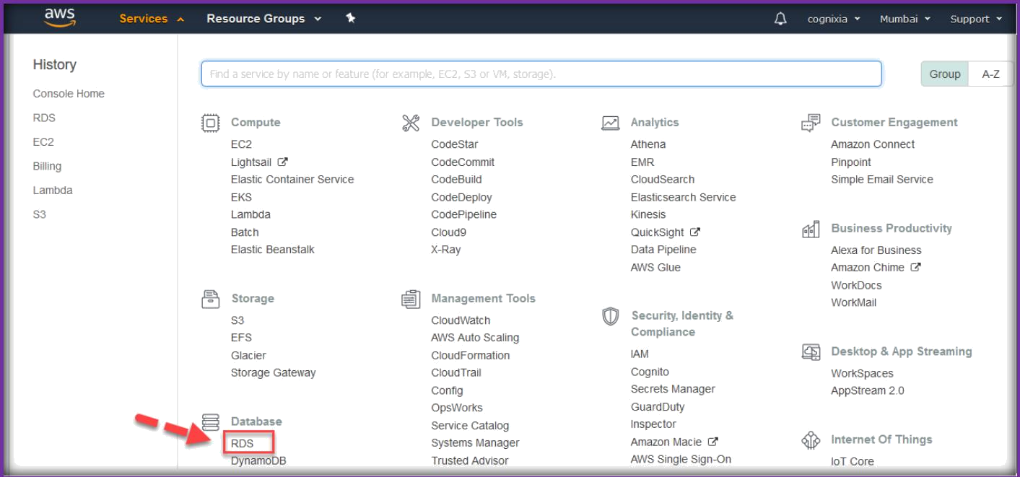
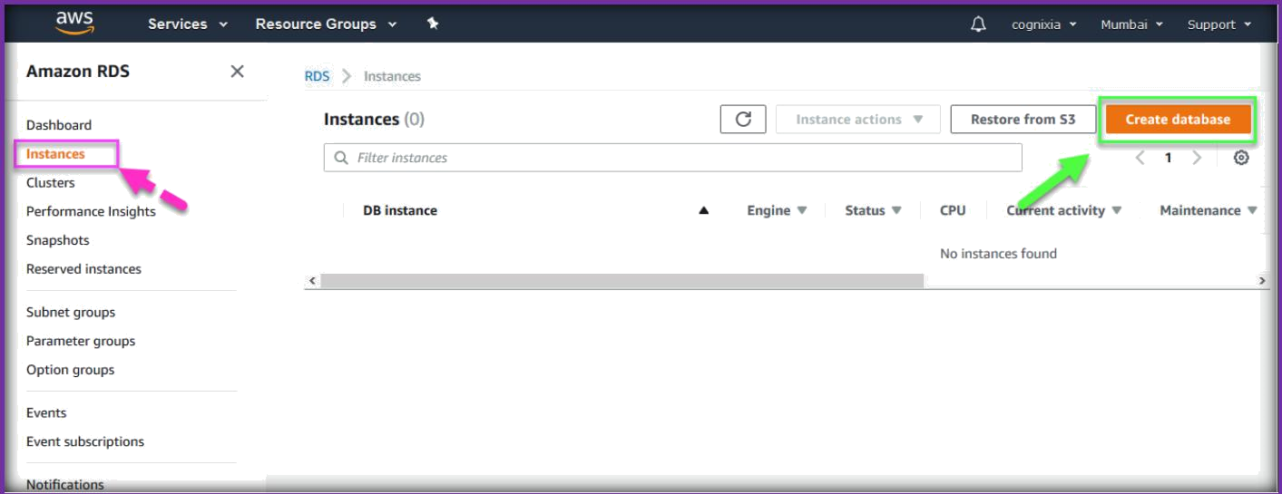
CREATING RDS DATABASE INSTANCE ON AWS
Once you logged in to AWS management console, Choose RDS from Database section under AWS services.
In the next page, select Instances from the left pane and click on Create database to start spinning up a database instance.

Slide 6
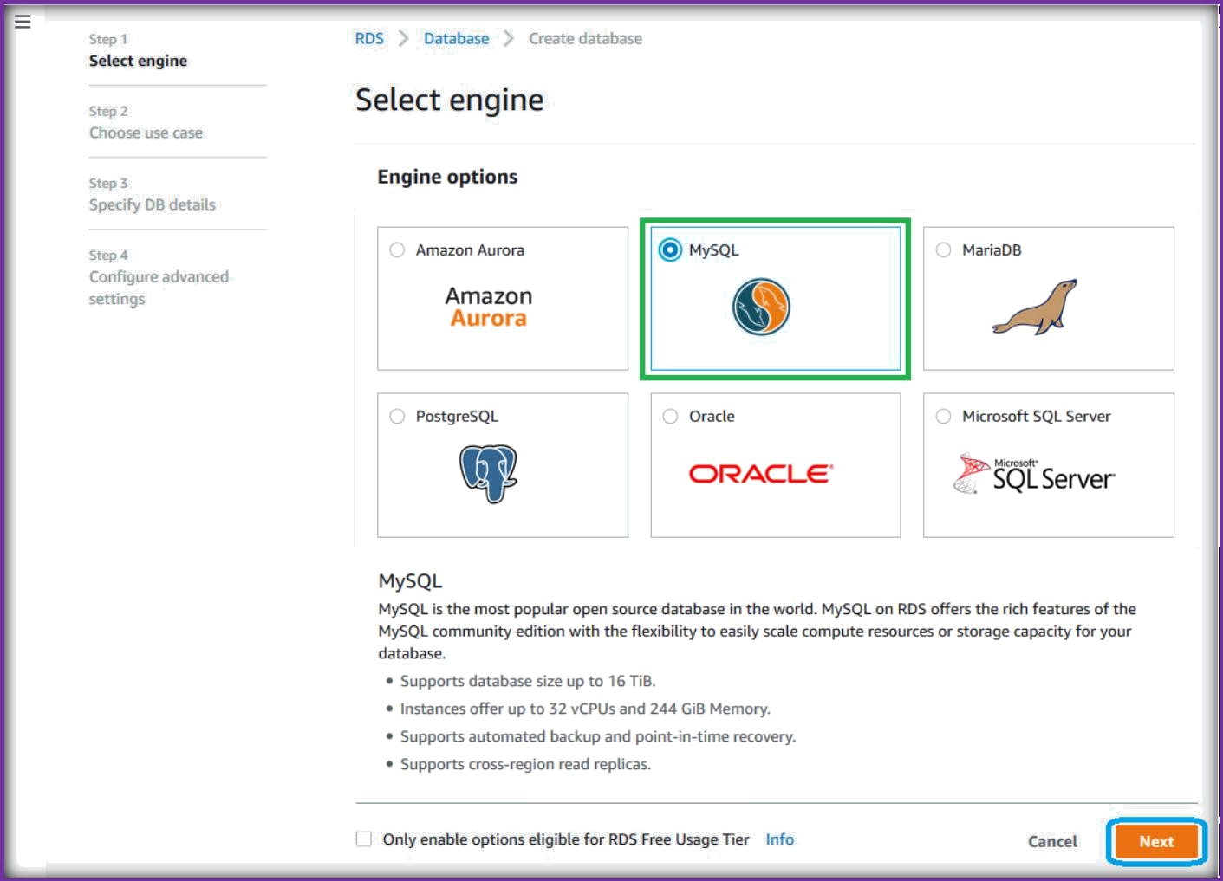
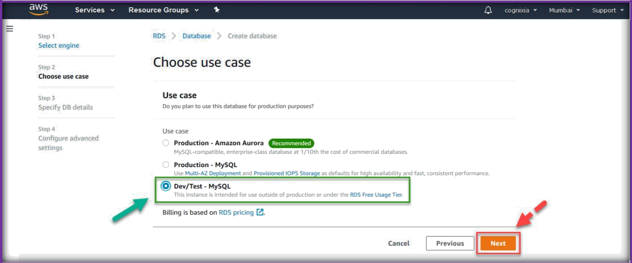
Select the database flavor and click on next to continue.
Choose use case as Dev/Test -Mysql and then click on Next.

Slide 7
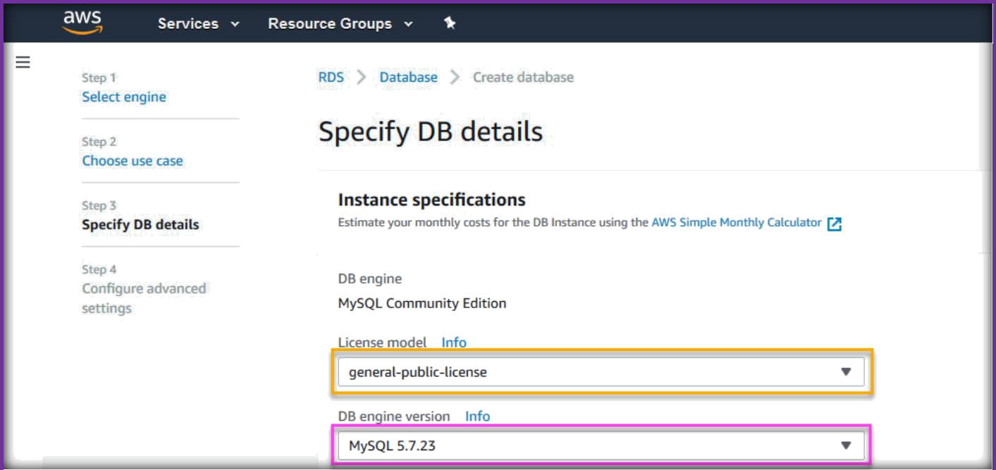
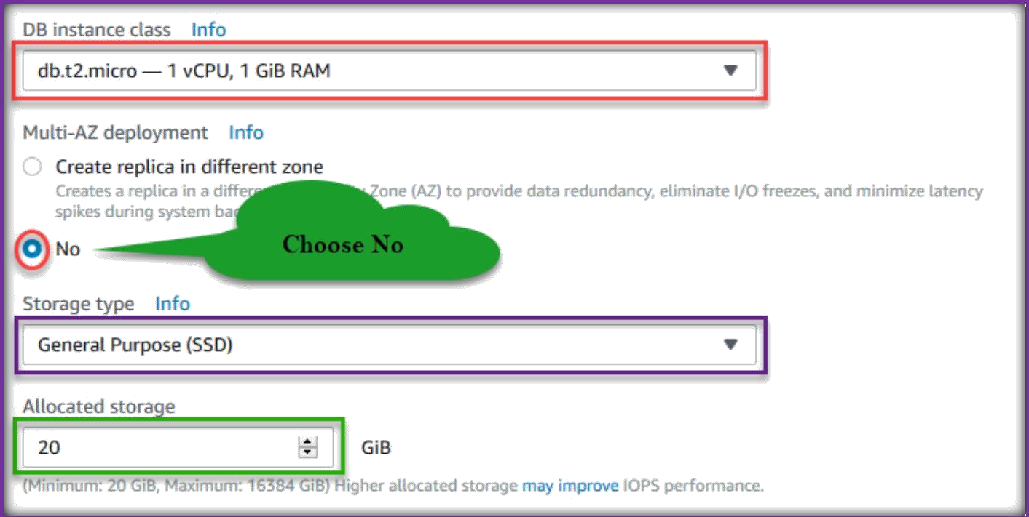
Select license model and engine version as per your requirement.
Select Instance type and specify Multi AZ information, choose Storage type, and specify the storage for your database in gb’s.

Slide 8
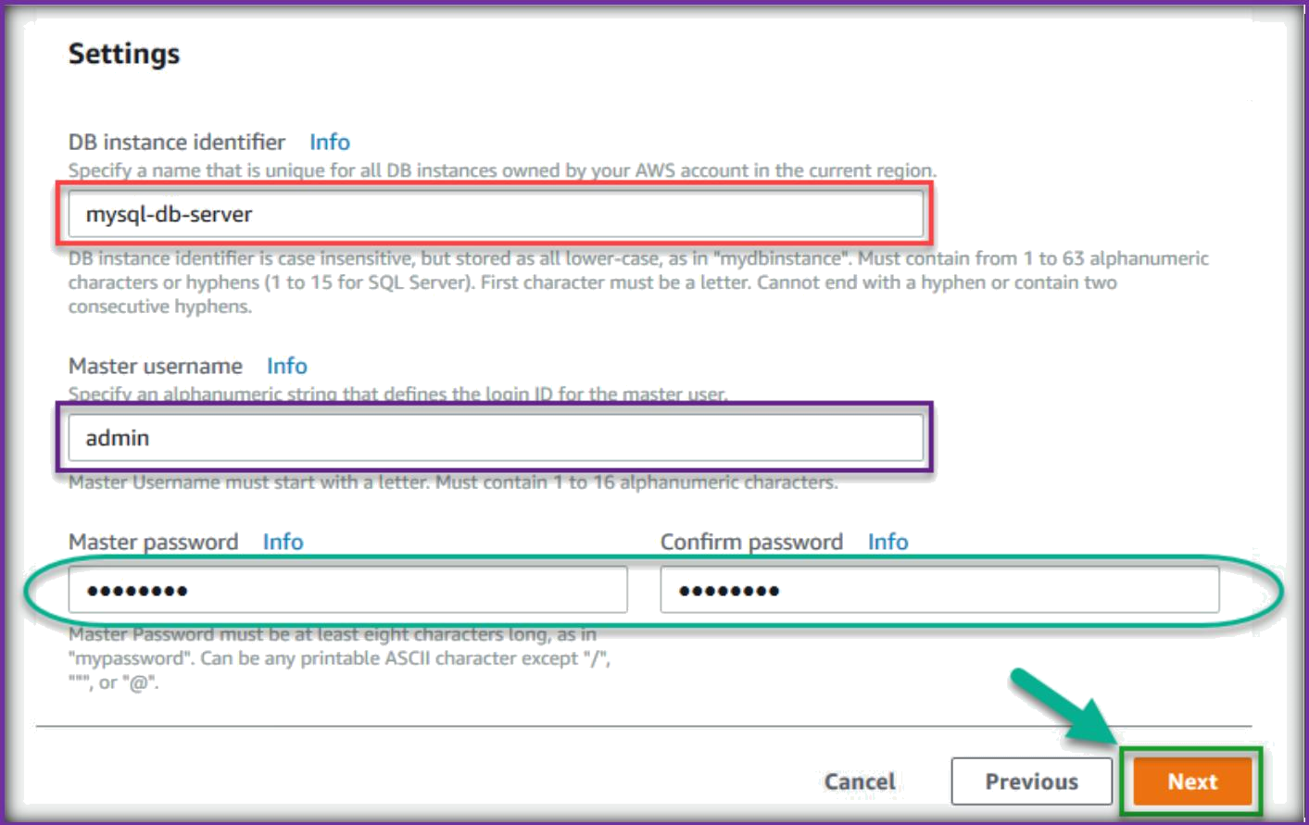
Next, specify a tag name, provide user name and password which you want to use to connect to database server.
Under Network & Security choose VPC configurations.
Select VPC from VPC drop down list.
Select Default for Subnet Group.
Choose either Yes or No for Public accessibility.
Specify an Availability Zone from the drop-down list.
Choose VPC security groups from the list.

Slide 9
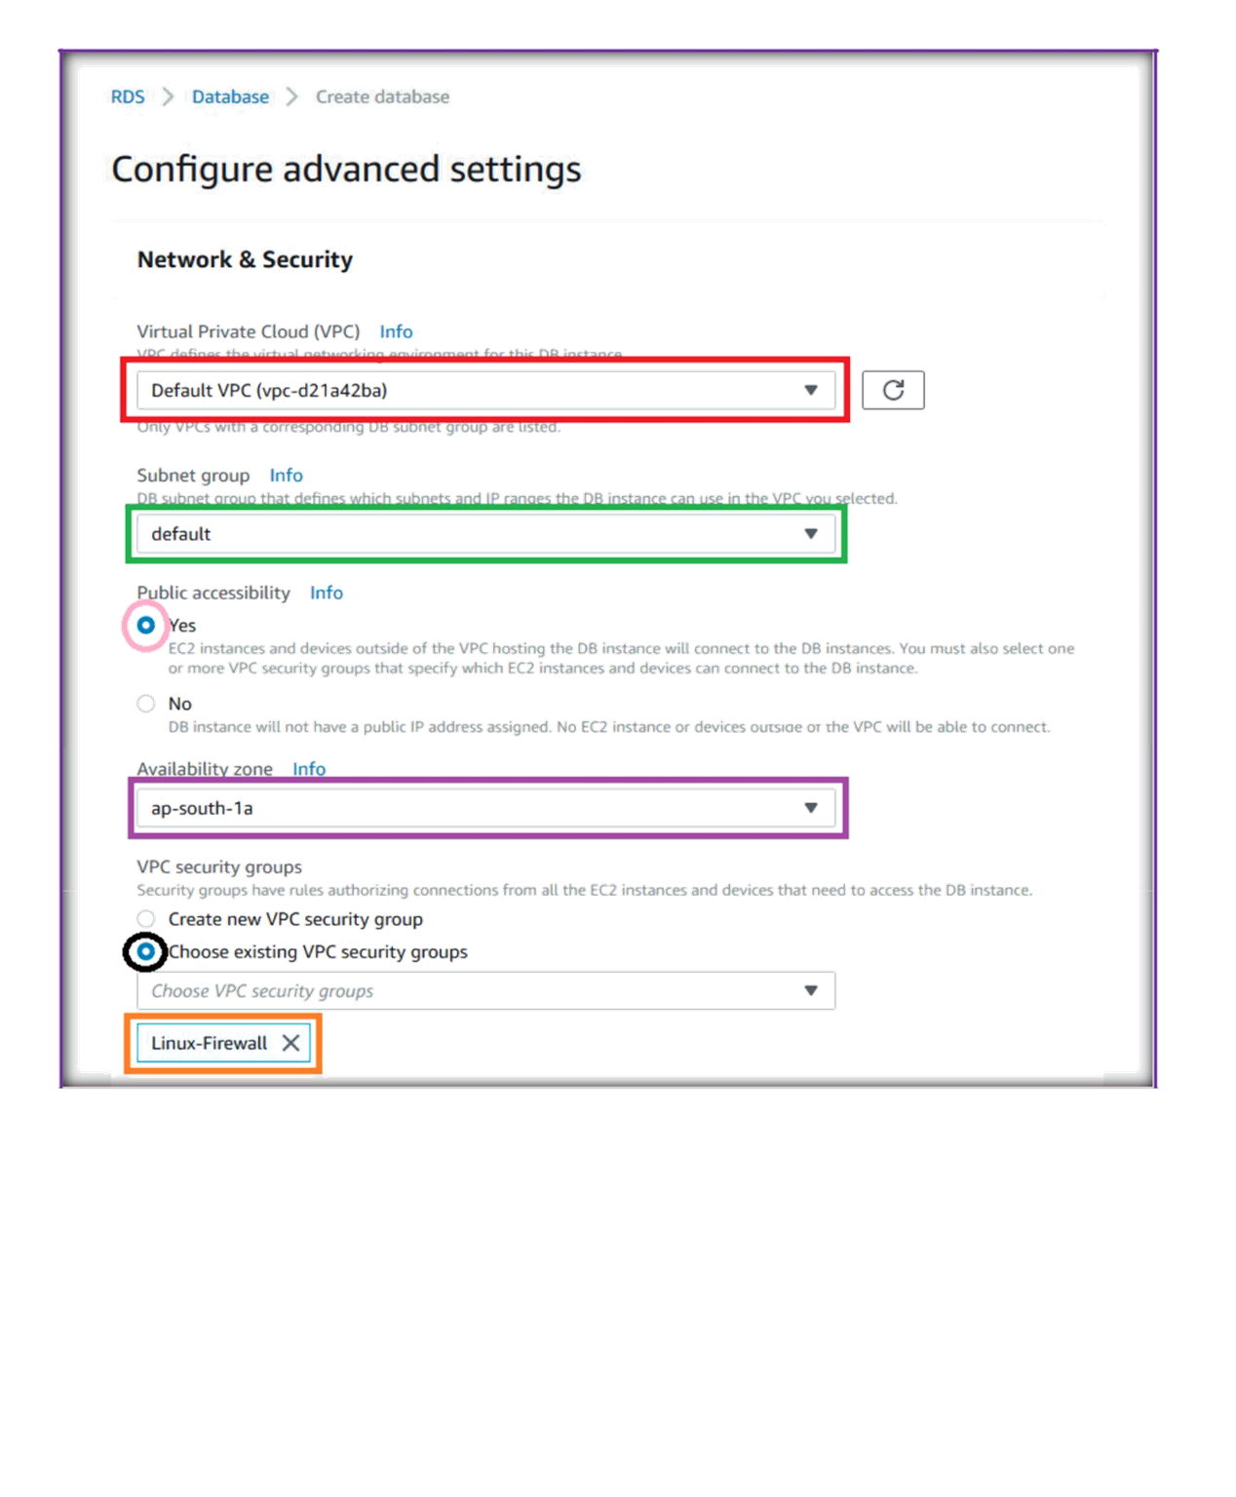

Slide 10
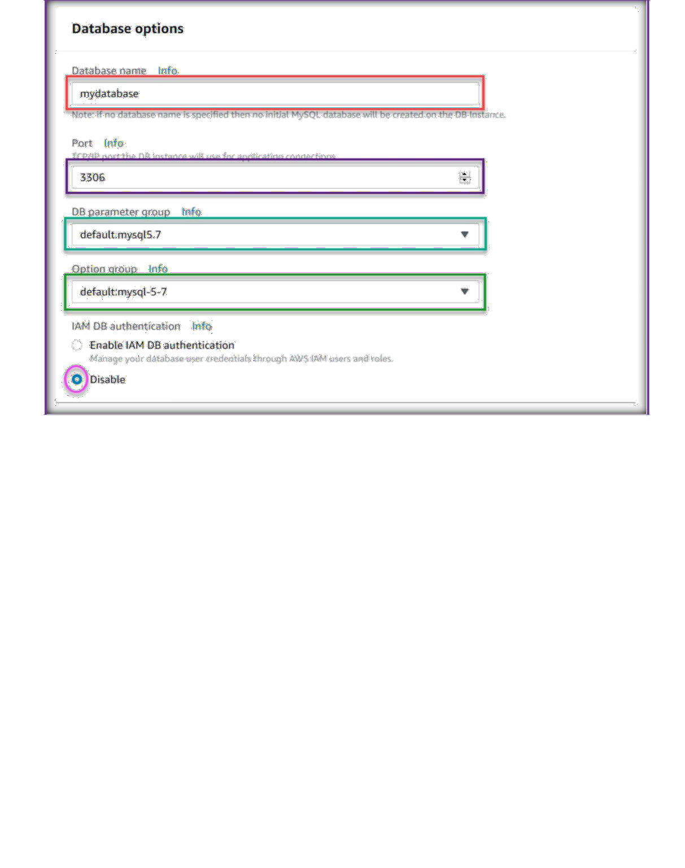
Under database options, specify a database name to be created with in the rds instance.
Specify Database port to run RDS instance.
Choose DB Parameter and Option groups.
Choose Disable IAM DB authentication.

Slide 11
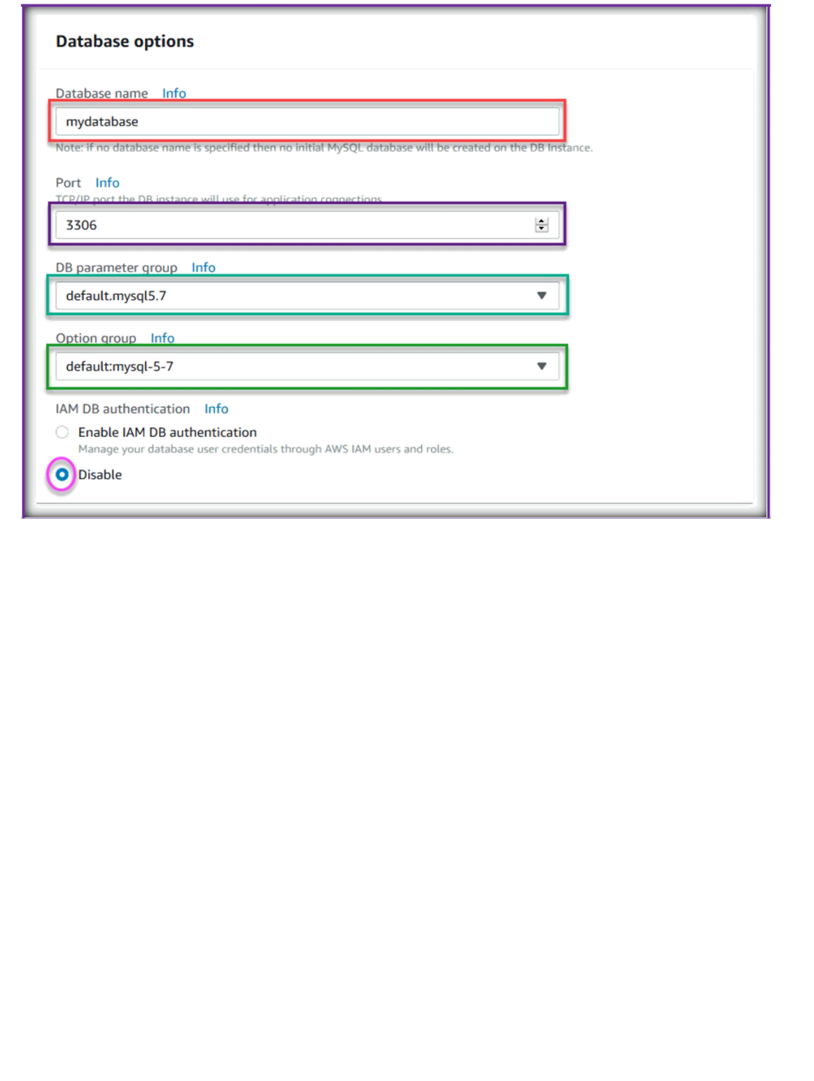
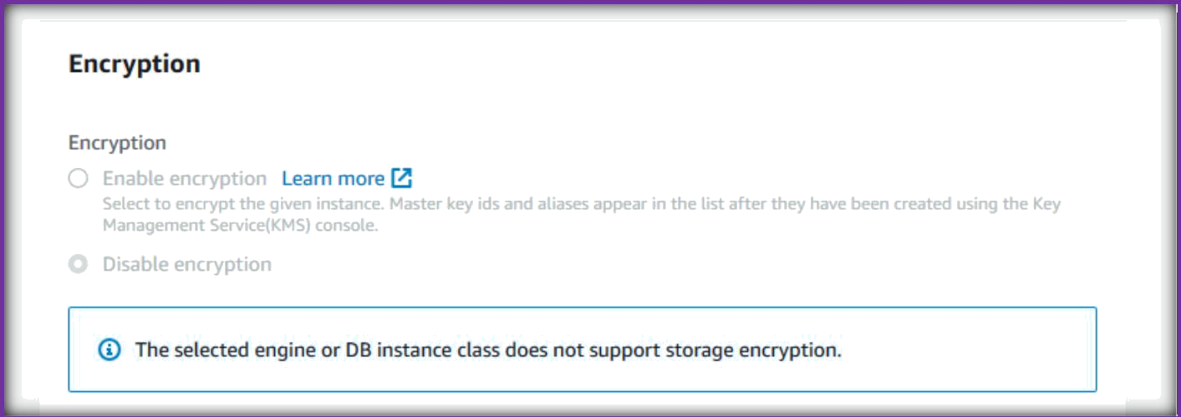
We can specify the encryption, if we need for the database instance.

Slide 12
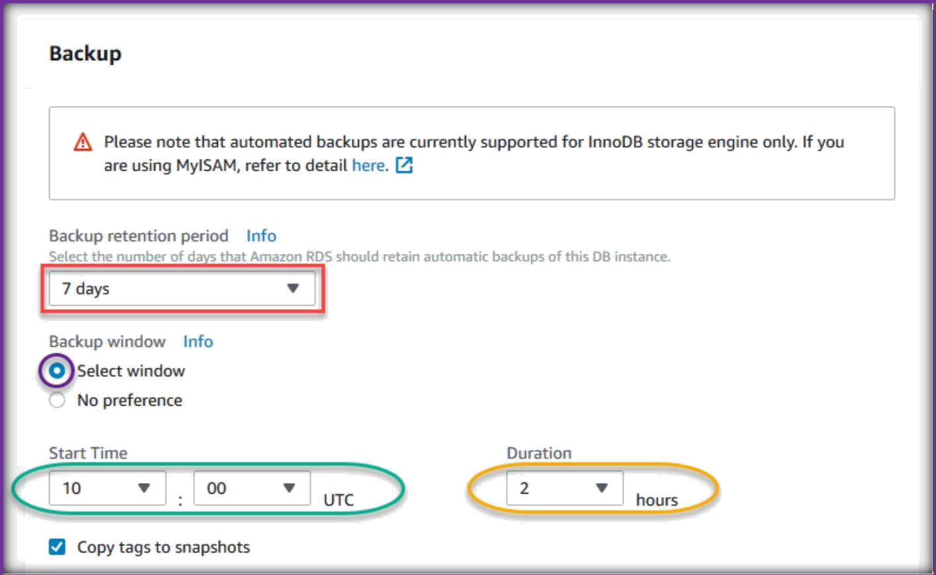
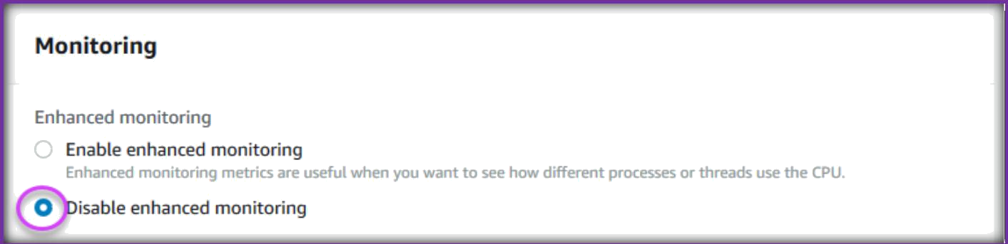
Under the Backup section, specify backup, monitoring, and maintenance details.
Like how many days of backups you need for this RDS instance.
Backup window period time and duration.
Choose the monitoring mode as enable Enhanced monitoring or disable.

Slide 13
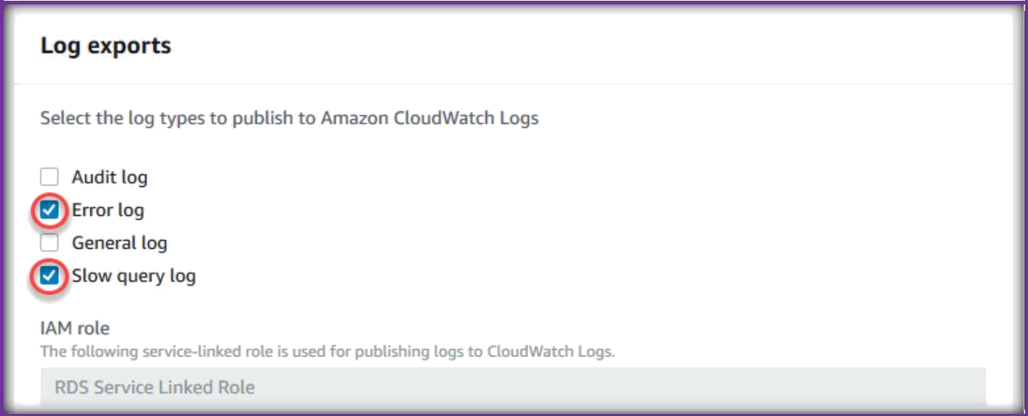
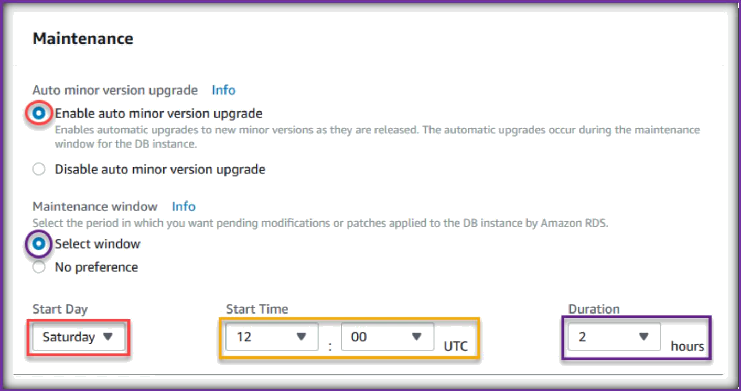
Select which logs from your db server to export to cloud watch service.
Under maintenance section choose following things.
Minor upgrades and patches to be installed or not.
Specify when to install upgrades and patches in UTC format.

Slide 14
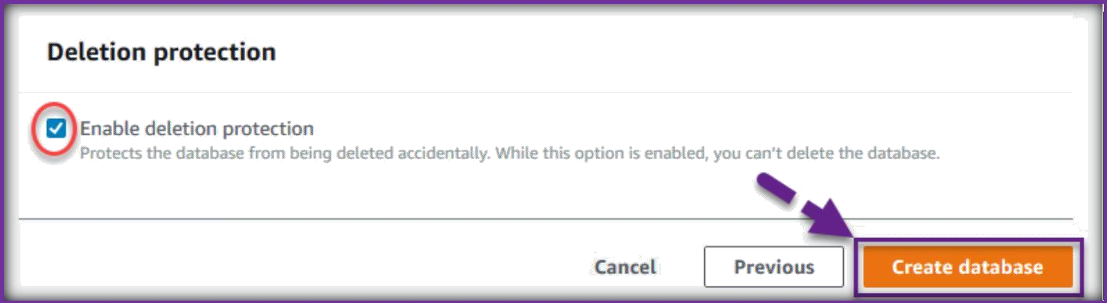
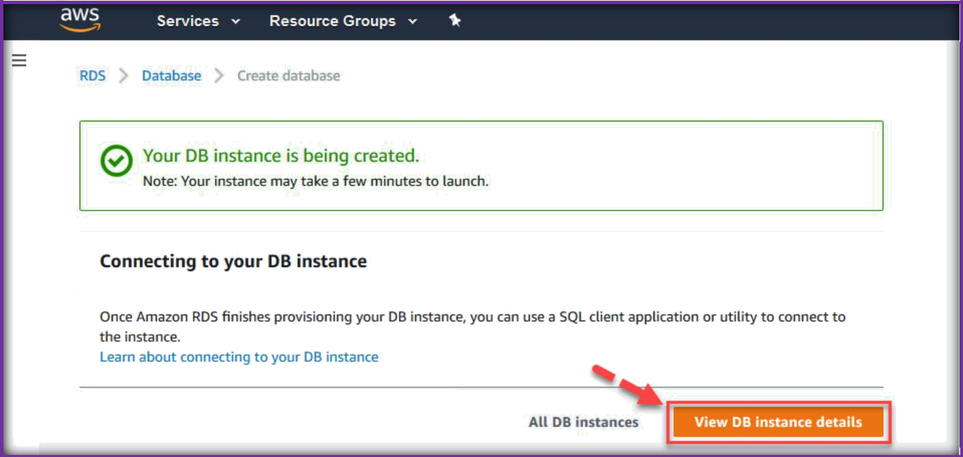
Specify deletion protection, then click on Create Database to create the DB server.
Click on View your DB Instances to see the instances.

Slide 15
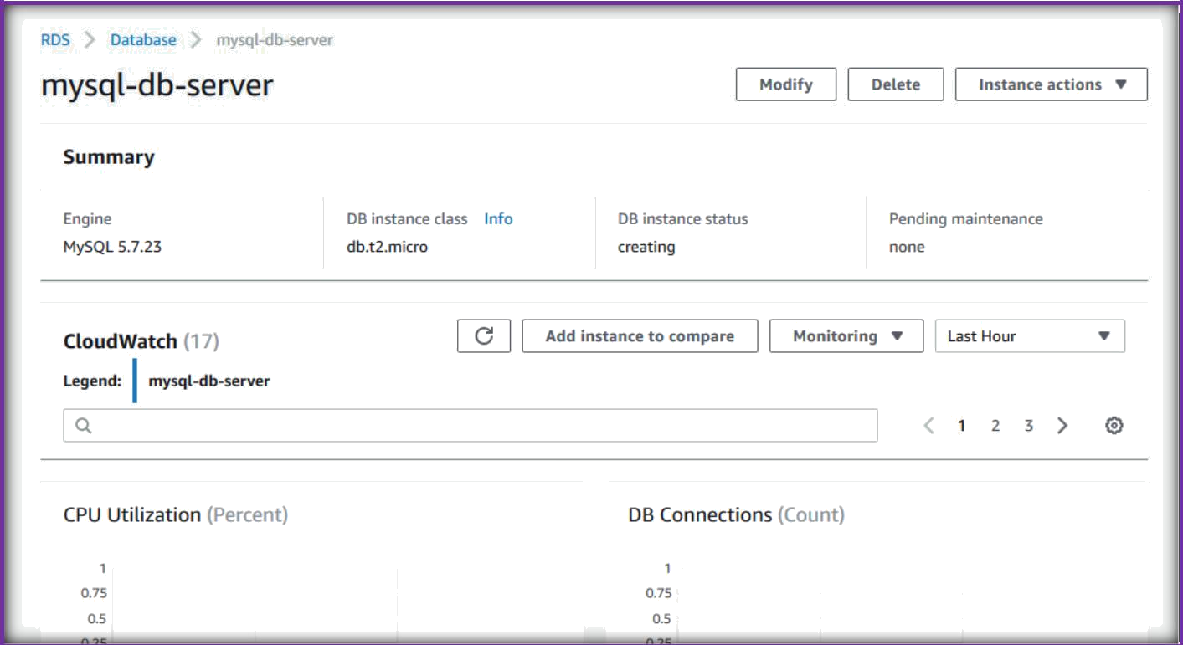
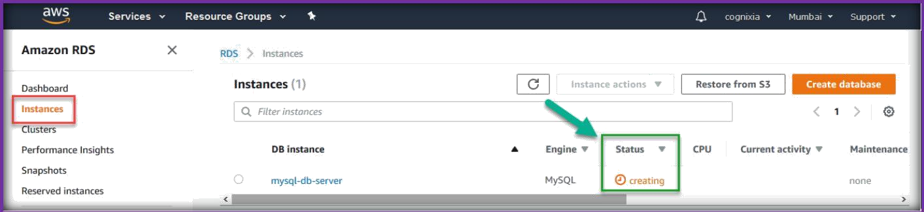
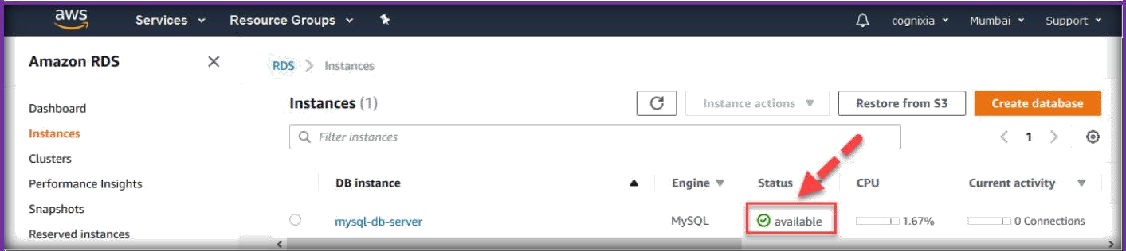
It will display all the configuration details of the DB server.
Go to Instances from the left pane to see the instance creation status.
Once RDS creation completed, the status will show as available.

Slide 16
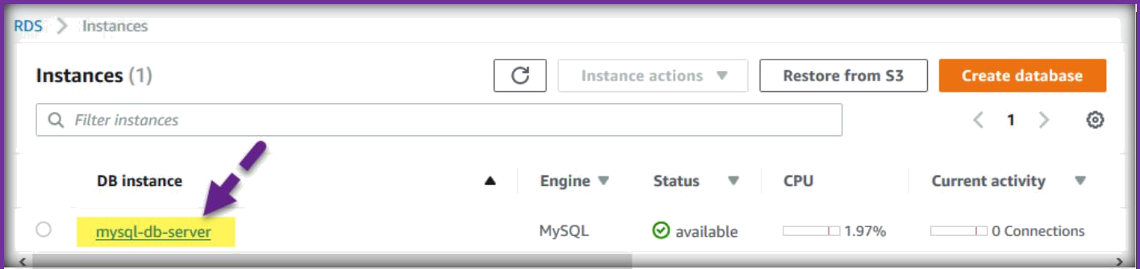
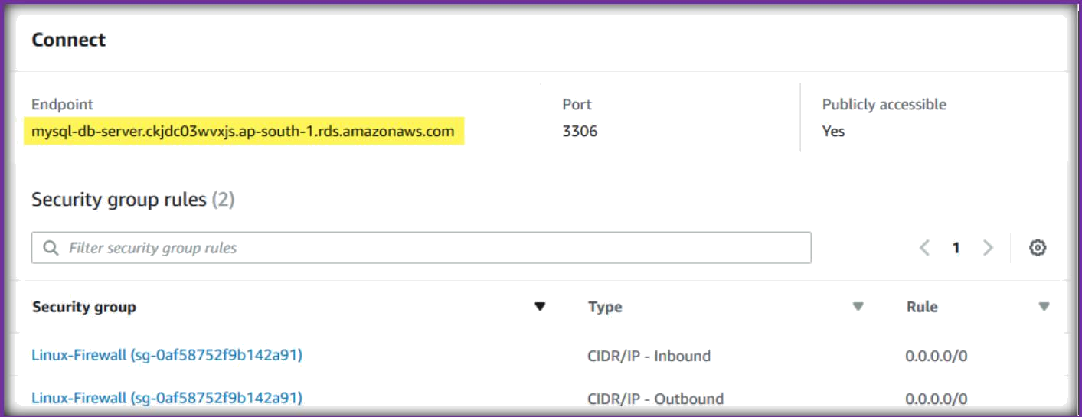
Next, click on the database tag name to go in to the db server details.
Summary page will open, on that page come to Connect section to see the connection details to connect to the database server.
Copy the Endpoint of the db server, will use this db endpoint to connect to this db server.
CONNECT TO RDS INSTANCE USING CLIENTS
Use MySQL clients to connect to RDS instances.
Specify End Point as Host or IP Address, Port 3006, and specify user and password combination to connect to RDS DB instance.

Slide 17
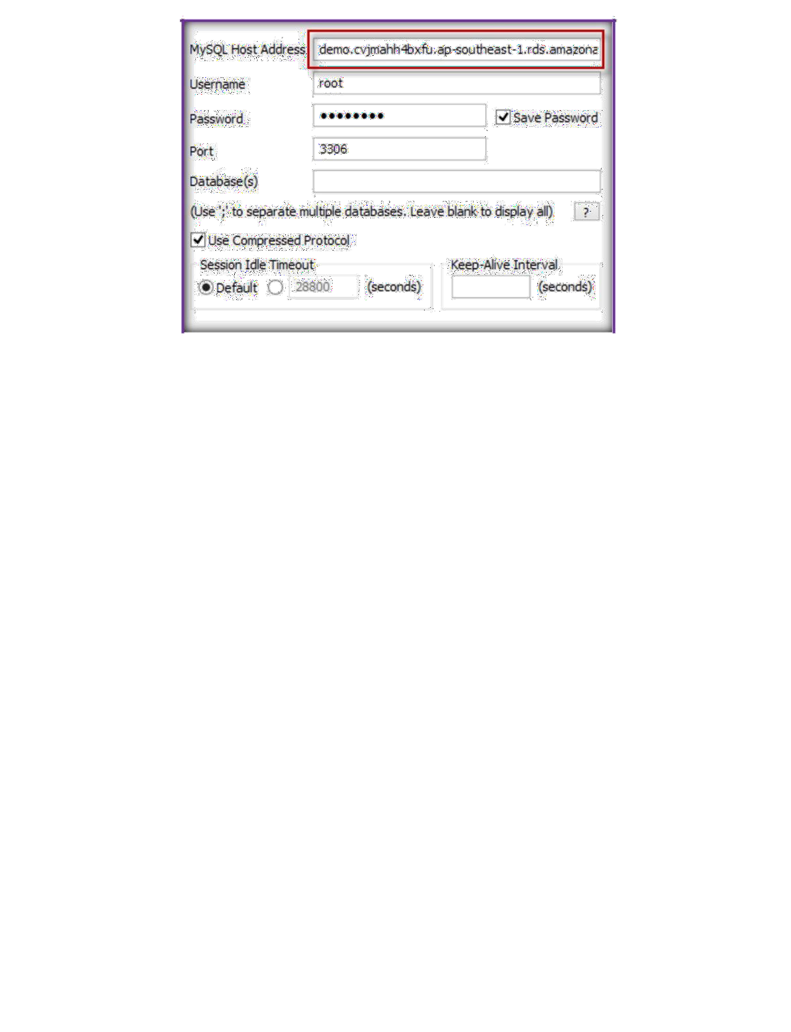
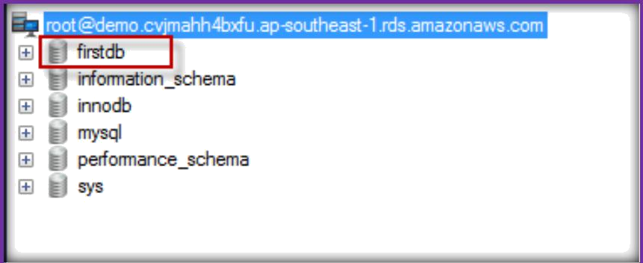
Once connected you can be able see the databases available on RDS.
Make sure to open DB instance port to connect in RDS security Group, otherwise you will not be able to connect.
TERMINATE RDS DB INSTANCE
Once you are in RDS page, click in Instances tab.
Then select instance, go to Instance Actions tab, choose Delete to RDS DB Instance.

Slide 18
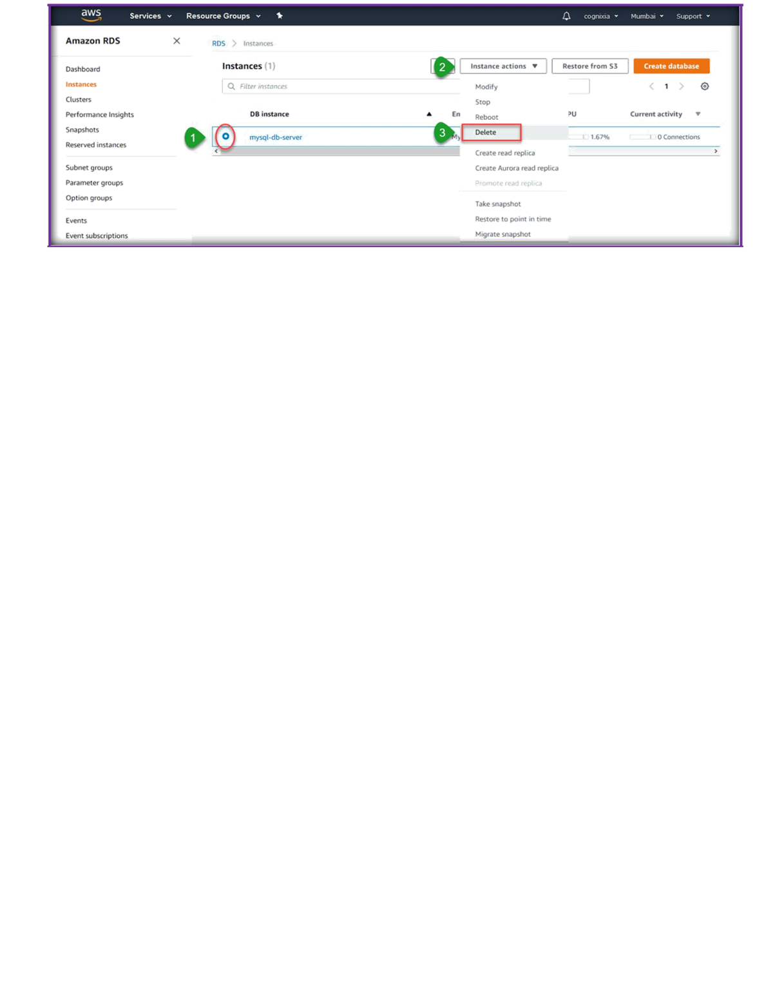
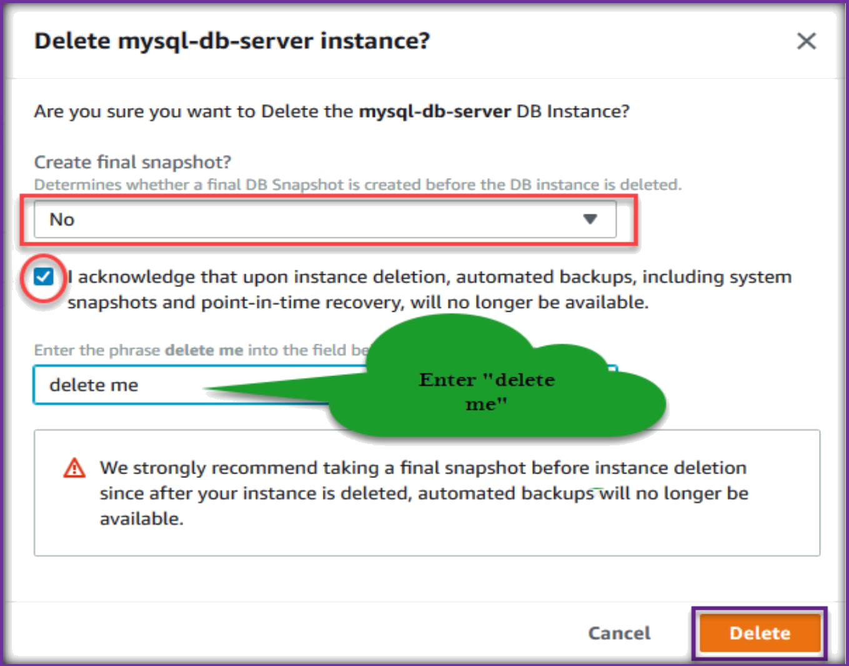
Next, no for create final snapshot, acknowledge it, then enter “delete me”, next click on Delete.

